Slide 1
FACTORING COMPLETELY

Slide 2
FACTORING COMPLETELY STEPS
1. Always Check for a GCF!!!!
If there is a GCF take it out!
2. How Many Terms are There????
Two terms: Difference of Two Squares
Three terms:
If the Coefficient is 1, Use the Shortcut
ALWAYS FACTOR COMPLETELY WHICH MEANS EVERYTHING IS IN ITS SIMPLEST FORM!!!
Factors of C that Add to B

Slide 3

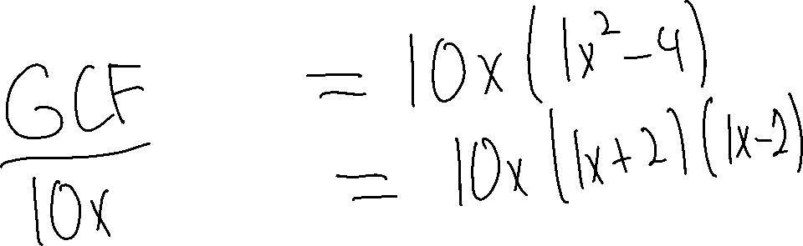
Ex. 1) $10x^{3}−40x$

Slide 4


Ex. 2) $t^{4}−16$

Slide 5

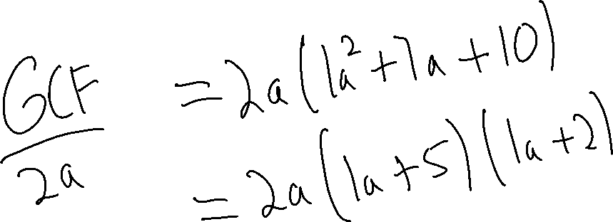
Ex. 3) $2a^{3}+14a^{2}+20a$

Slide 6

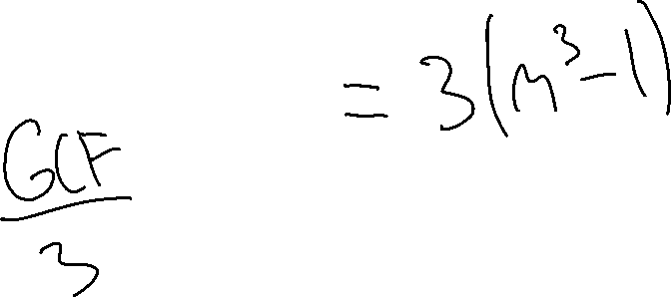
Ex. 4) $3m^{3}−3$

Slide 7

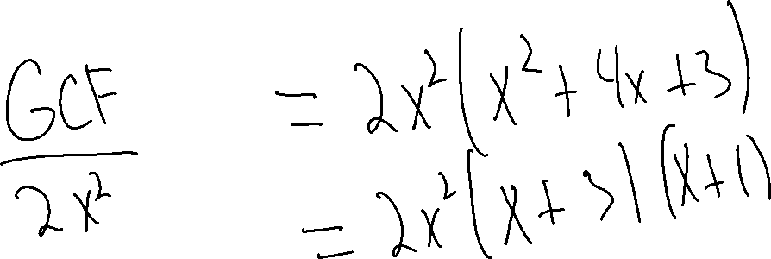
Ex. 5) $2x^{4}+8x^{3}+6x^{2}$

Slide 8

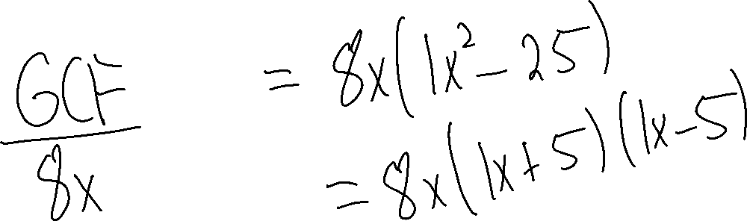
Ex. 6) $8x^{3}−200x$

Slide 9

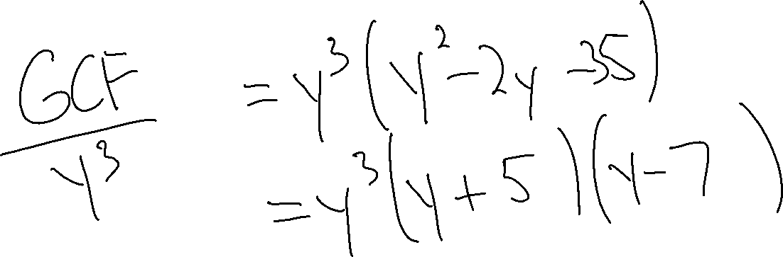
Ex. 7) $y^{5}−2y^{4}−35y^{3}$

Slide 10
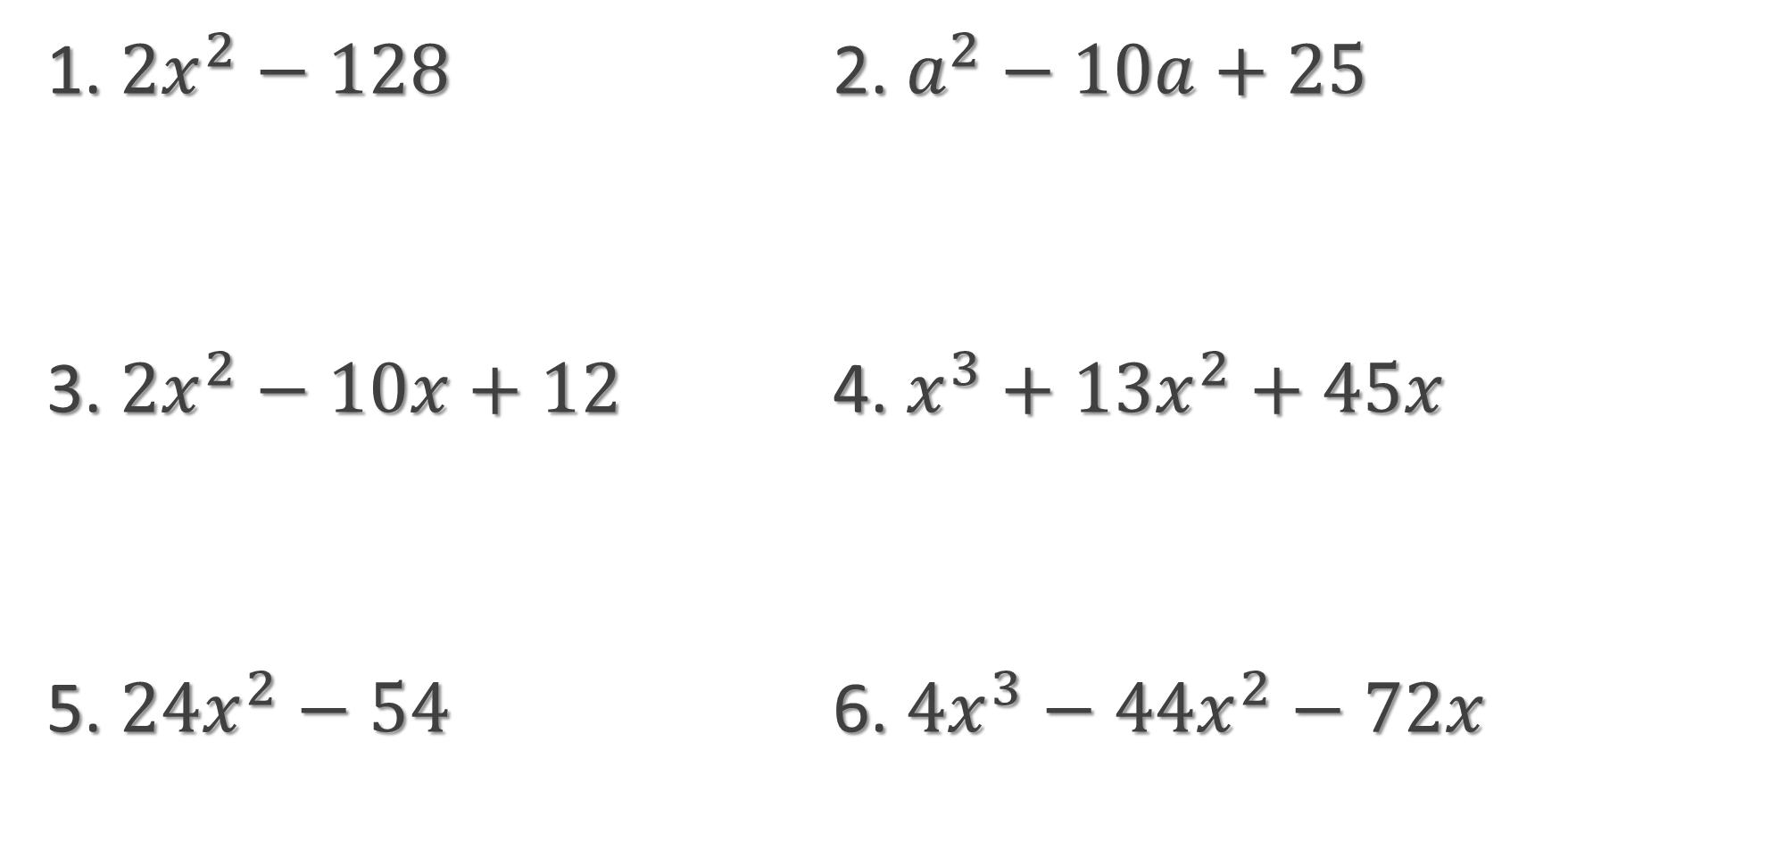
Try These
1. $2x^{2}−128$ 2. $a^{2}−10a+25$
3. $2x^{2}−10x+12$ 4. $x^{3}+13x^{2}+45x$
5. $24x^{2}−54$ 6. $4x^{3}−44x^{2}−72x$

